Slide 1
3
rootlpno
birthtype
confineno
birthdate
deathdate
status
2
Data Check
Linked Data File
1
deathdate
status
4
rootlpno
birthdate
confineno
birthdate
deathdate
status
rootlpno
birthtype
confineno
birthdate
deathdate
status
followup
Cumulative incidence
5
rootlpno
birthtype
confineno
birthdate
deathdate
status
followup
6
Survival

Slide 2
Hospital morbidity
Save File
Save File
1
3
dthdate
5
rootlpno
rootlpno
dthcode
rootlpno
dthdate
cansite1
dthcode
cantis1
candate1
candate2
cantis2
cansite2
6
7
rootlpno
dthdate
cansite1
dthcode
cantis1
candate1
candate2
yearsep
cantis2
treat
cansite2
8
Mortality Register
On file filter period
1st January 1995 – 31st December 2010
rootlpno
yearsep
dthdate
cansite1
treat
dthcode
cantis1
candate1
candate2
cantis2
2
cansite2
rootlpno
dthdate
dthcode
9
On file filter age > 40
rootlpno
yearsep
dthdate
cansite1
treat
dthcode
cantis1
candate1
candate2
cantis2
cansite2
10
Cancer Register
On file, filter patients with first three years period after first hospitalization (admission date)
rootlpno
treat
dthdate
cansite1
yearsep
dthcode
cantis1
candate1
candate2
cantis2
4
cansite2
rootlpno
cansite1
cantis1
candate1
candate2
cantis2
cansite2
11
12
rootlpno
treat
dthdate
cansite1
yearsep
dthcode
cantis1
Save File
candate1
candate2
fileseq
cantis2
cansite2
morbseq
dead
13
14
17
rootlpno
treat
readmvar
Save Syntax
dthdate
cansite1
yearsep
dthcode
cantis1
candate1
candate2
fileseq
dead
cantis2
On file, calculate the hospitalization rate hoprate, treat = 1 & morbseq = 1, readmseq =1 / sum(followup)
cansite2
morbseq
15
18
16
rootlpno
treat
dthdate
cansite1
yearsep
dthcode
cantis1
readmvar
projectid
candate1
candate2
fileseq
dead
followup
Save File
cantis2
hoprate
cansite2
morbseq

Slide 3
Women only
(age group)
Total Population
Population at risk
MEN
WOMEN
< 25
25 - 75
25 - 75
> 25

Slide 4
Confounding
Definition
Identification
Problems Caused
Mitigation

Slide 5
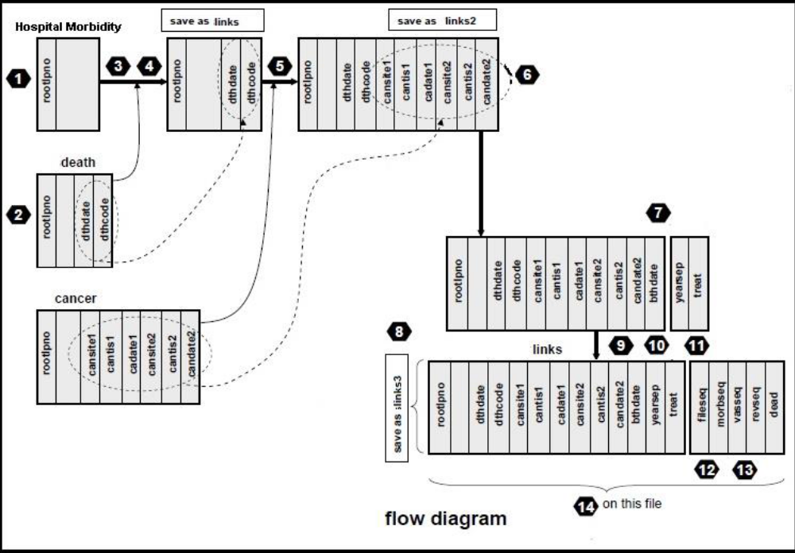

Slide 6
vashmds
save as vaslinks
save as vaslinks2
save as vaslinks3
1
3
4
5
6
7
rootlpno
rootlpno
rootlpno
cansite1
candate2
rootlpno
candate2
cantis1
cansite2
cantis2
cansite1
cantis1
cansite2
dthcode
cadate1
dthcode
cadate1
cantis2
dthcode
dthdate
dthdate
dthdate
bthdate
vasdeath
2
rootlpno
dthcode
dthdate
Part A
8
Part B
rootlpno
cansite1
cadate1
candate2
cantis1
cansite2
dthdate
cantis2
dthcode
yearsep
vascancer2
bthdate
treat
rootlpno
cansite1
candate2
14
vaslinks
9
11
13
cantis1
cadate1
cansite2
cantis2
cansite1
cantis1
cansite2
cadate1
cantis2
fileseq
dead
rootlpno
dthcode
candate2
treat
morbseq
revseq
dthdate
bthdate
vasseq
save as vaslinks4
yearsep
vasbirth
2
bthdate
10
12
rootlpno
15
on this file
Exercise 2 flow diagram
16
save your syntax

